Slide 1
Chapter 8 Discrete Probability

Slide 2
Content
8.1 Definitions
8.2 Mean and Variance
8.3 Probability Generating Functions
8.4 Flipping Coins
8.5 Hashing

Slide 3
Content
8.1 Definitions
8.2 Mean and Variance
8.3 Probability Generating Functions
8.4 Flipping Coins
8.5 Hashing

Slide 4
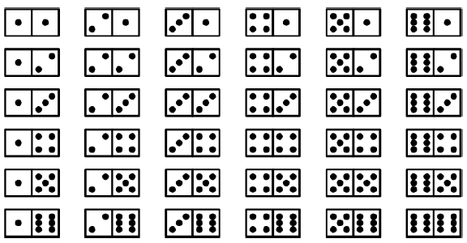
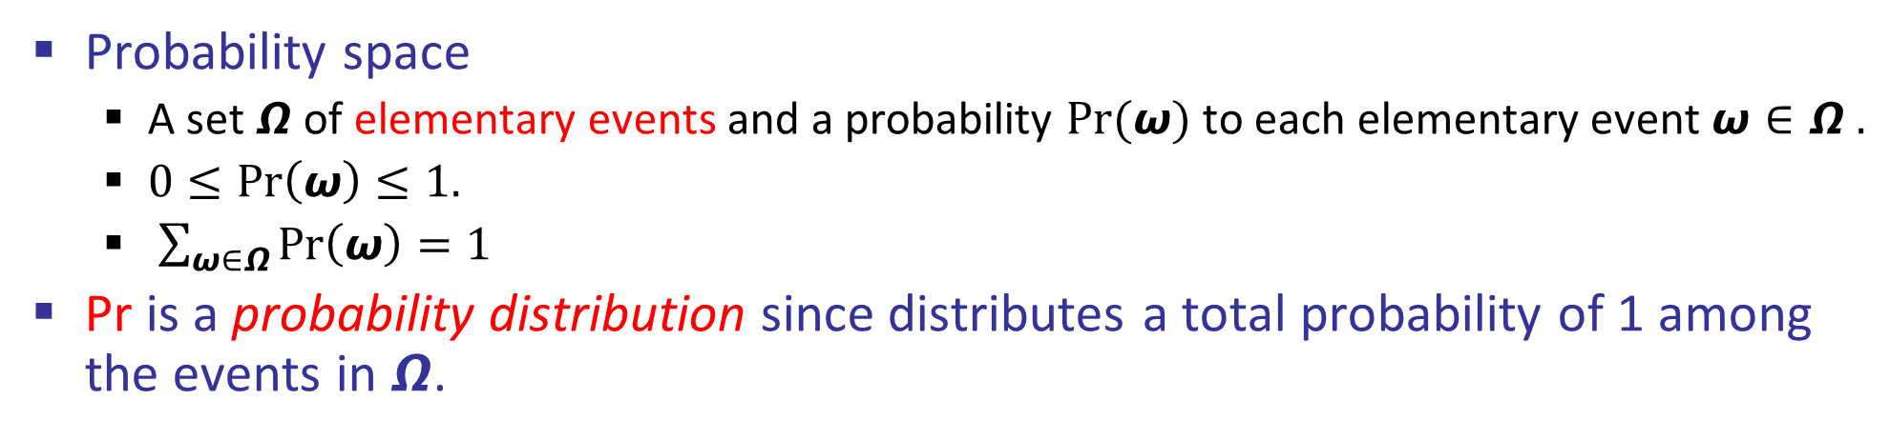
Probability Space (概率空间)
Probability space
A set $Ω$of elementary events and a probability $Pr(ω)$ to each elementary event $ω∈Ω .$
$0≤Pr\left(ω\right)≤1.$
$\sum_{ω∈Ω}{Pr\left(ω\right)}=1$
Pr is a probability distribution since distributes a total probability of 1 among the events in$Ω$.
If we are rolling a pair of dice, then the probability space has 6*6=36 elementary events and the probability for each elementary event is 1/36.

Slide 5
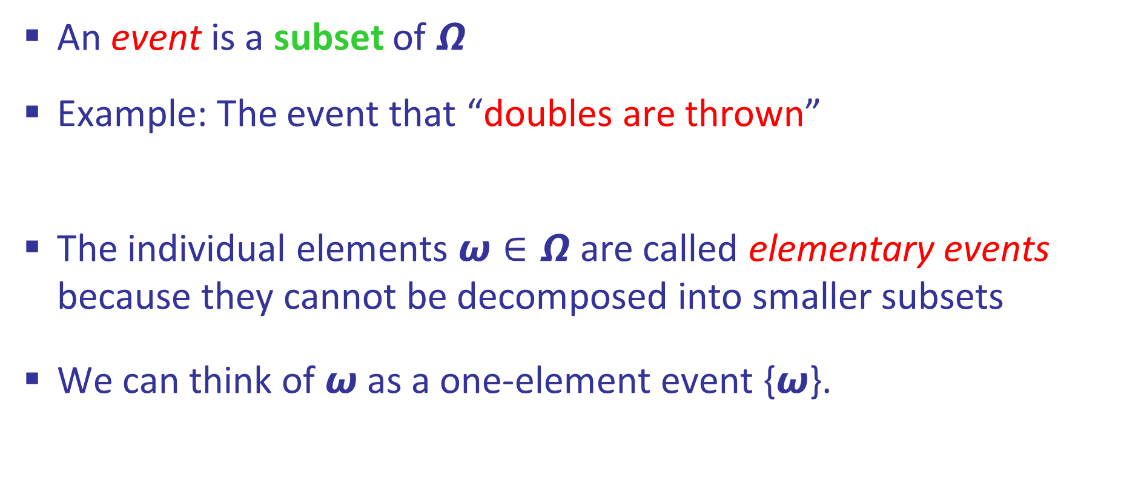
Event （事件）
An event is a subset of $Ω$
Example: The event that “doubles are thrown”
The individual elements $ω∈Ω$ are called elementary events because they cannot be decomposed into smaller subsets
We can think of $ω$ as a one-element event {$ω$}.

Slide 6

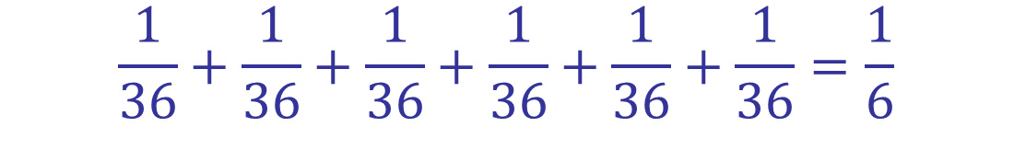
The probability of an event
The probability of an event $A$ is defined as
$$\operatorname{Pr}\left(ω∈A\right)=\sum_{ω∈A}{Pr({ω) }}$$
Example: The probability of the event that “doubles are thrown with fair dice” is
$$\frac{1}{36}+\frac{1}{36}+\frac{1}{36}+\frac{1}{36}+\frac{1}{36}+\frac{1}{36}=\frac{1}{6}$$

Slide 7
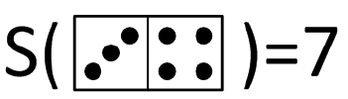
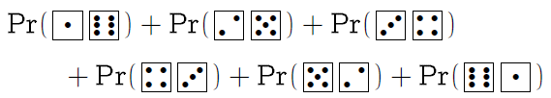
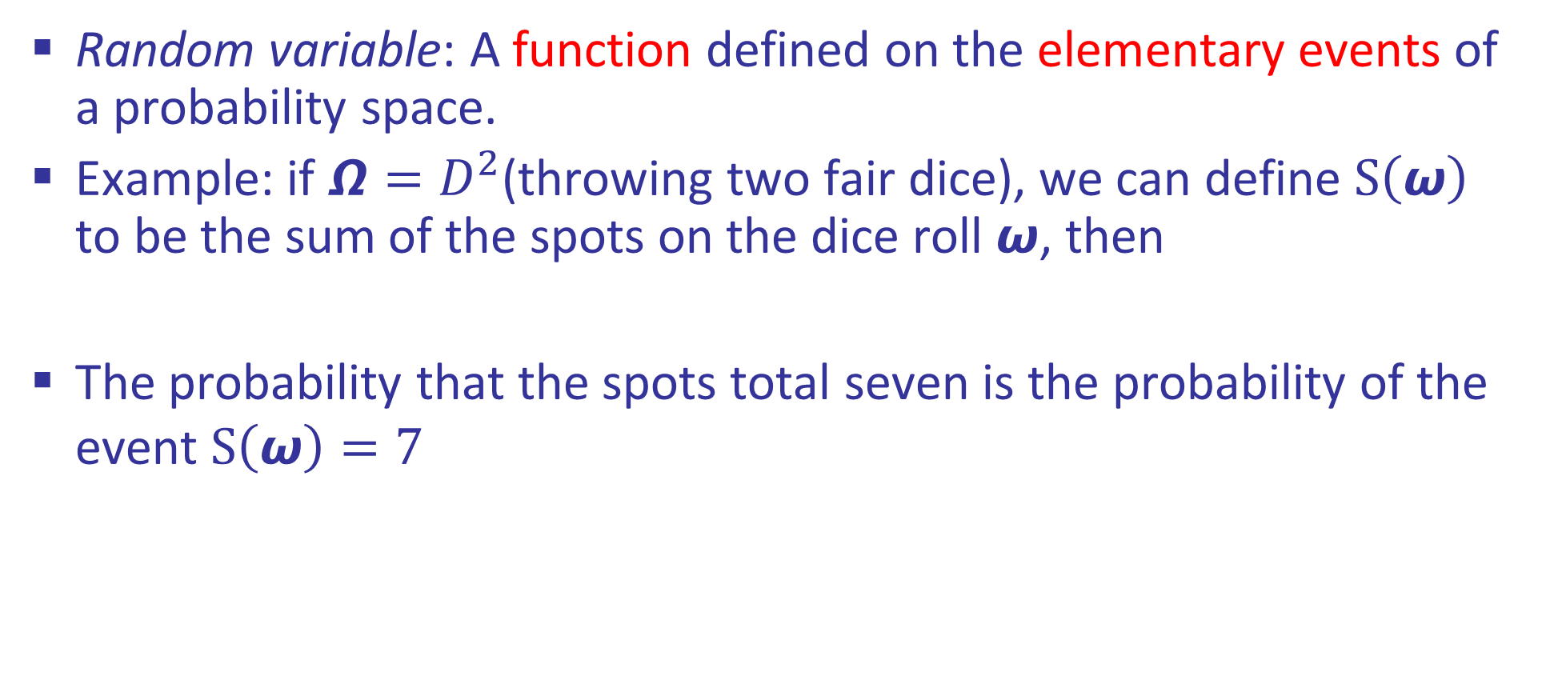
Random Variable (随机变量)
Random variable: A function defined on the elementary events of a probability space.
Example: if $Ω=D^{2}$(throwing two fair dice), we can define $S\left(ω\right)$ to be the sum of the spots on the dice roll $ω$, then
The probability that the spots total seven is the probability of the event $S\left(ω\right)=7$

Slide 8
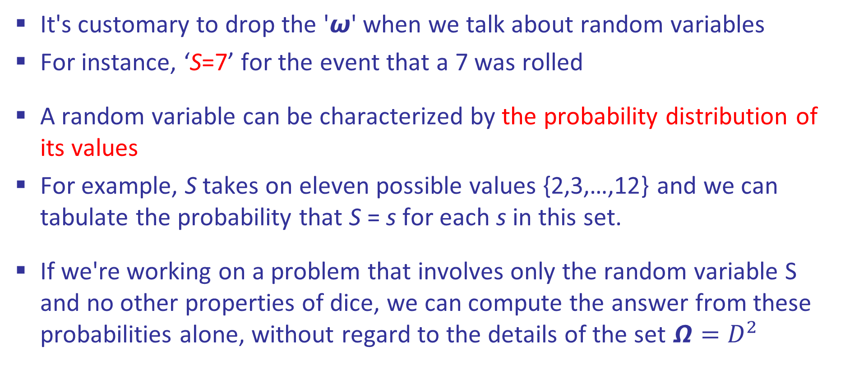
Random Variable (随机变量)
It's customary to drop the '$ω$' when we talk about random variables
For instance, ‘S=7’ for the event that a 7 was rolled
A random variable can be characterized by the probability distribution of its values
For example, S takes on eleven possible values {2,3,…,12} and we can tabulate the probability that S = s for each s in this set.
If we're working on a problem that involves only the random variable S and no other properties of dice, we can compute the answer from these probabilities alone, without regard to the details of the set $Ω=D^{2}$
Notes:
demo

Slide 9

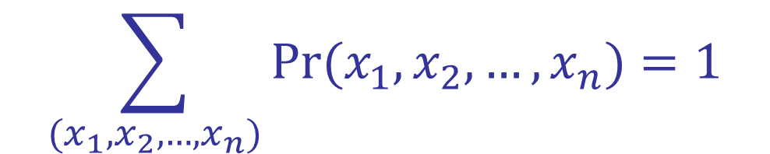

Joint Distribution (联合分布)
Given two random variables X and Y, their joint distribution is
$$\operatorname{Pr}\left(X=x,Y=y\right)=\operatorname{Pr}\left(X=x and Y=y\right)$$
More generally, a joint distribution over a set of random variables:
$$\operatorname{Pr}\left(X_{1}=x_{1},X_{2}=x_{2},…,X_{n}=x_{n}\right)=Pr(x_{1}, x_{2},…, x_{n})$$
Must obey:
$$\operatorname{Pr}\left(T,W\right)$$
$$Pr(x_{1}, x_{2},…, x_{n})≥0$$
T | W | P
hot | sun | 0.4
hot | rain | 0.1
cold | sun | 0.2
cold | rain | 0.3
$$\sum_{(x_{1}, x_{2},…, x_{n})}{Pr(x_{1}, x_{2},…, x_{n})}=1$$

Slide 10

Independence (独立性)

Slide 11


Independence (独立性)
Two random variables X and Y are independent if
This says that their joint distribution factors into a product of two simpler distributions
Another form:
$$∀x,y:\operatorname{Pr}\left(x, y\right)=\operatorname{Pr}\left(x\right)Pr⁡(y)$$
$$∀x,y:\operatorname{Pr}\left(x|y\right)=\operatorname{Pr}\left(x\right)$$
Independence is a simplifying modeling assumption
Empirical joint distributions: at best “close” to be independent

Slide 12




Example: Independence ?
$$\operatorname{Pr}\left(T\right)$$
T | P
hot | 0.5
cold | 0.5
$$\operatorname{Pr}\left(T,W\right)$$
$$\operatorname{Pr}\left(T,W\right)$$
T | W | P
hot | sun | 0.4
hot | rain | 0.1
cold | sun | 0.2
cold | rain | 0.3
T | W | P
hot | sun | 0.3
hot | rain | 0.2
cold | sun | 0.3
cold | rain | 0.2
$$\operatorname{Pr}\left(W\right)$$
W | P
sun | 0.6
rain | 0.4

Slide 13






Example: Independence
N fair, independent coin flips:
$$\operatorname{Pr}\left(X_{1}\right)$$
$$\operatorname{Pr}\left(X_{2}\right)$$
$$\operatorname{Pr}\left(X_{n}\right)$$
H | 0.5
T | 0.5
H | 0.5
T | 0.5
H | 0.5
T | 0.5
$$\operatorname{Pr}\left(X_{1},X_{2},…,X_{n}\right)$$

Slide 14
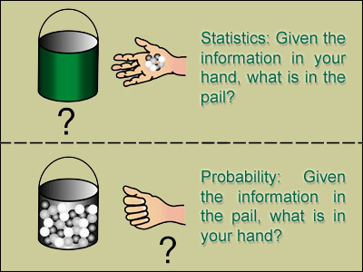
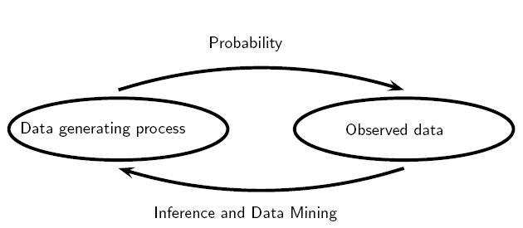
注释：概率与统计的区别与联系
Hence, mean, median and mode are statistical concepts but they have probabilistic counterparts

Slide 15
Mean, Median and Mode (Statistical aspect)
The notion of “average” value
Mean: the sum of all values, divided by the number of values
Median: the middle value, numerically
Mode: the value that occurs most often
Example: {3,1,4,1,5}. After sorting, (1,1,3,4,5)
Mean= 14/5=2.8
Median=3
Mode=1

Slide 16

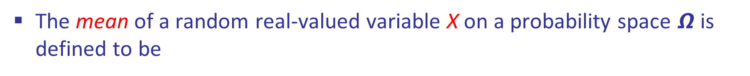



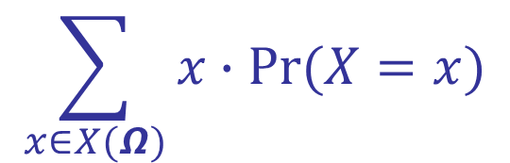
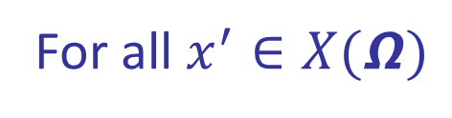
Mean, Median and Mode (Probabilistic aspect)
The mean of a random real-valued variable X on a probability space $Ω$ is defined to be
$$\sum_{x∈X(Ω)}{x∙Pr(X=x)}$$
Here $X(Ω)$ stands for the set of all values that X can assume
The median of X is defined to be the set of all x such that
$$Pr⁡(X≤x)≥1/2$$
$$Pr⁡(X≥x)≥1/2$$
The mode of X is defined to be the set of all x such that
$$Pr⁡(X=x)≥Pr⁡(X=x^{′})$$
For all $x^{′}∈X(Ω)$

Slide 17
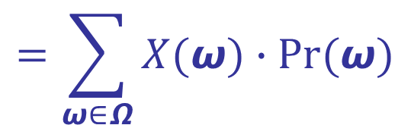
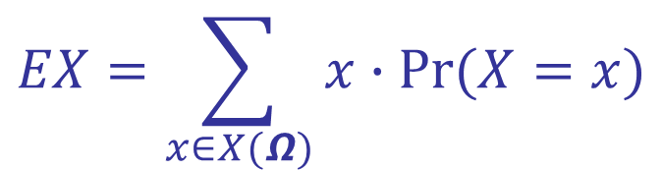
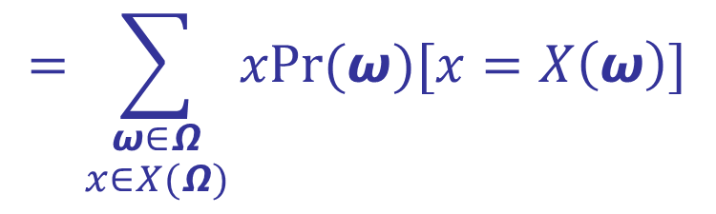
Expected Value (期望值)
The mean of a random variable X is typically called expected value
$$EX=\sum_{x∈X(Ω)}{x∙Pr(X=x)}$$
$$=\sum_{ω∈Ω}{X(ω)∙Pr(ω)}$$
$$=\sum_{\begin{aligned}ω∈Ω \\ x∈X(Ω)\end{aligned}}{xPr(ω)[x=X\left(ω\right)]}$$

Slide 18
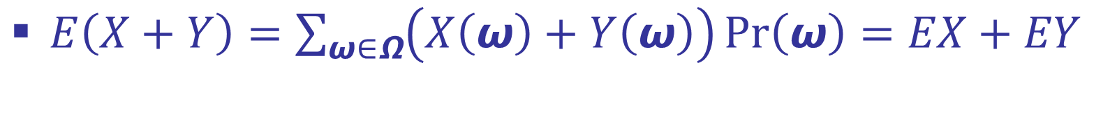
Some properties of expected value
$E\left(X+Y\right)=\sum_{ω∈Ω}{\left(X\left(ω\right)+Y\left(ω\right)\right)\operatorname{Pr}\left(ω\right)}=EX+EY$
$E\left(αX\right)=αEX$
$E\left(XY\right)=(EX)(EY)$ if X and Y are independent

Slide 19
Content
8.1 Definitions
8.2 Mean and Variance
8.3 Probability Generating Functions
8.4 Flipping Coins
8.5 Hashing

Slide 20



Variance (方差)
The variance of a random variable X is defined as mean square deviation from the mean
$$VX=E({(X−EX)}^{2})$$
$$=E(X^{2}−2XEX+{(EX)}^{2})$$
$$=E(X^{2})−2(EX)(EX)+{(EX)}^{2}$$
$$=E(X^{2})−{(EX)}^{2}$$
The variance measures the “spread” of X’s distribution
The standard deviation is defined as the square root of the variance
$$σ=\sqrt{VX}$$

Slide 21

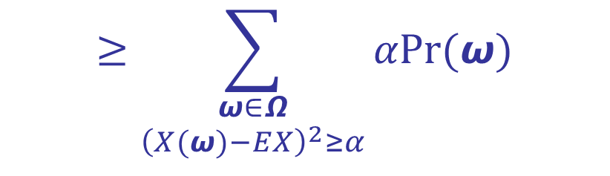
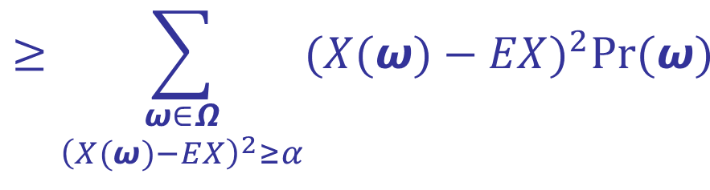
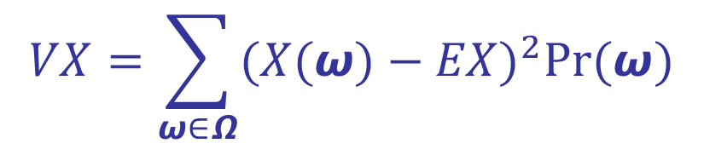
Chebyshev’s Inequality
Chebyshev’s inequality: $Pr⁡({\left(X−EX\right)}^{2}≥α)≤VX/α$
Roughly, it means that a random variable X will rarely be far from its mean EX if its variance VX is small
Its proof is simple
$$VX=\sum_{ω∈Ω}{{(X(ω)−EX)}^{2}Pr(ω)}$$
$$≥\sum_{\begin{aligned}ω∈Ω \\ {\left(X(ω)−EX\right)}^{2}≥α\end{aligned}}{{(X(ω)−EX)}^{2}Pr(ω)}$$
$$≥\sum_{\begin{aligned}ω∈Ω \\ {\left(X(ω)−EX\right)}^{2}≥α\end{aligned}}{αPr(ω)}$$
$$=αPr⁡({\left(X−EX\right)}^{2}≥α)$$

Slide 22
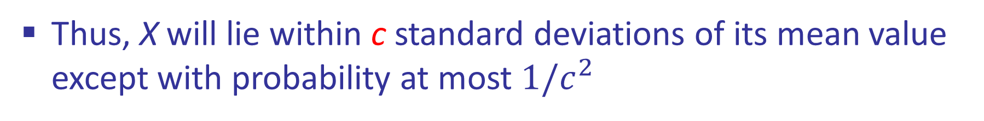


Chebyshev’s Inequality
Corollary of Chebyshev’s inequality: $Pr⁡(|X−μ|≥cσ)≤1/c^{2}$
This corollary can be obtained via replacing $α$ by $c^{2}VX$
$${(X−μ)}^{2}≥{(cσ)}^{2}$$
$${\left(X−EX\right)}^{2}≥α$$
Thus, X will lie within c standard deviations of its mean value except with probability at most $1/c^{2}$

Slide 23
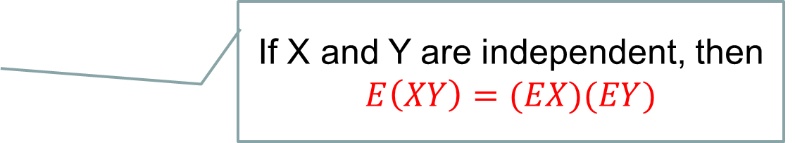
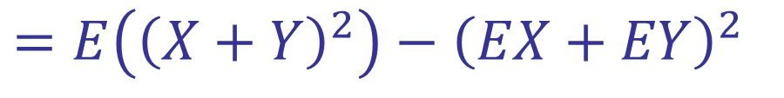
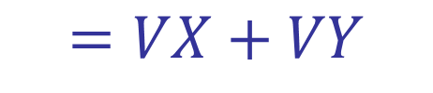
Chebyshev’s Inequality
Example: if we roll a pair of fair dice n times, the total value of the n rolls will almost always be near 7n, for large n
The variance of n independent rolls is 35n/6 (why?)
$V\left(X+Y\right)=E\left({\left(X+Y\right)}^{2}\right)−$ ${\left(E(X+Y)\right)}^{2}$
$=E\left({\left(X+Y\right)}^{2}\right)−$ ${\left(EX+EY\right)}^{2}$
$=E\left(X^{2}+Y^{2}+2XY\right)−$ ${\left(EX\right)}^{2}−{\left(EY\right)}^{2}−2(EX)(EY)$
$=E\left(X^{2})+E(Y^{2})+2E(XY\right)−$ ${\left(EX\right)}^{2}−{\left(EY\right)}^{2}−2(EX)(EY)$
$$=[E\left(X^{2})− {\left(EX\right)}^{2}]+[E(Y^{2})− {\left(EY\right)}^{2}]+2E(XY\right)−2(EX)(EY)$$
$$=VX+VY+2E(XY)−2(EX)(EY)$$
If X and Y are independent, then
$$E\left(XY\right)=(EX)(EY)$$
$$=VX+VY$$

Slide 24
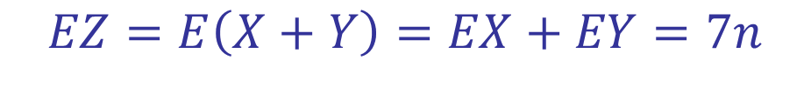
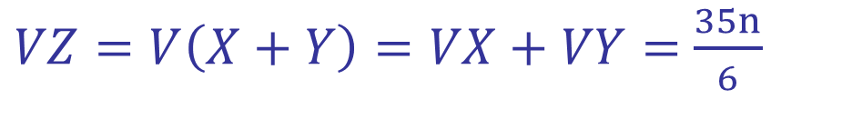
Chebyshev’s Inequality
If X and Y are independent, then $V\left(X+Y\right)=VX+VY$
If we roll a pair of fair dice n times, the total value of the n rolls Z=X+Y is the sum of two independent random variables, where X is the total value of the n rolls of the 1st dice and Y is the total value of the n rolls of the 2nd dice
$VX=E\left(X^{2}\right)−$ ${\left(EX\right)}^{2}=\frac{1}{6}（1^{2}n+2^{2}n+3^{2}n+4^{2}n+5^{2}n+6^{2}n）$
$−$ ${\left(\frac{1}{6}（1n+2n+3n+4n+5n+6n）\right)}^{2}=\frac{35n}{12}$
$In the same way, VY=$ $\frac{35n}{12}$
$VZ=V\left(X+Y\right)=VX+VY=$ $\frac{35n}{6}$
$$EZ=E\left(X+Y\right)=EX+EY=7n$$

Slide 25

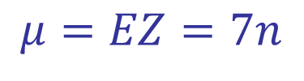
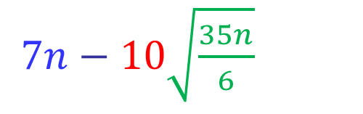
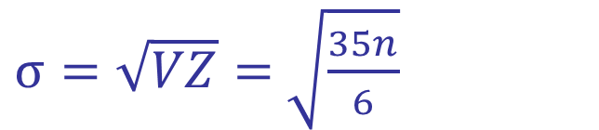
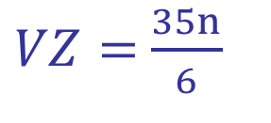
Chebyshev’s Inequality
Example: if we roll a pair of fair dice n times, the total value Z of the n rolls will almost always be near 7n, for large n
$$μ=EZ=7n$$
$VZ=$ $\frac{35n}{6}$
$σ=\sqrt{VZ}=$ $\sqrt{\frac{35n}{6}}$
According to $Pr⁡(|x−μ|≥cσ)≤1/c^{2}$, if we let c=10, then the final sum will lie between
$7n−10\sqrt{\frac{35n}{6}}$
and $7n+10\sqrt{\frac{35n}{6}}$
with a probability of at least $1−\frac{1}{c^{2}}=99\%$

Slide 26
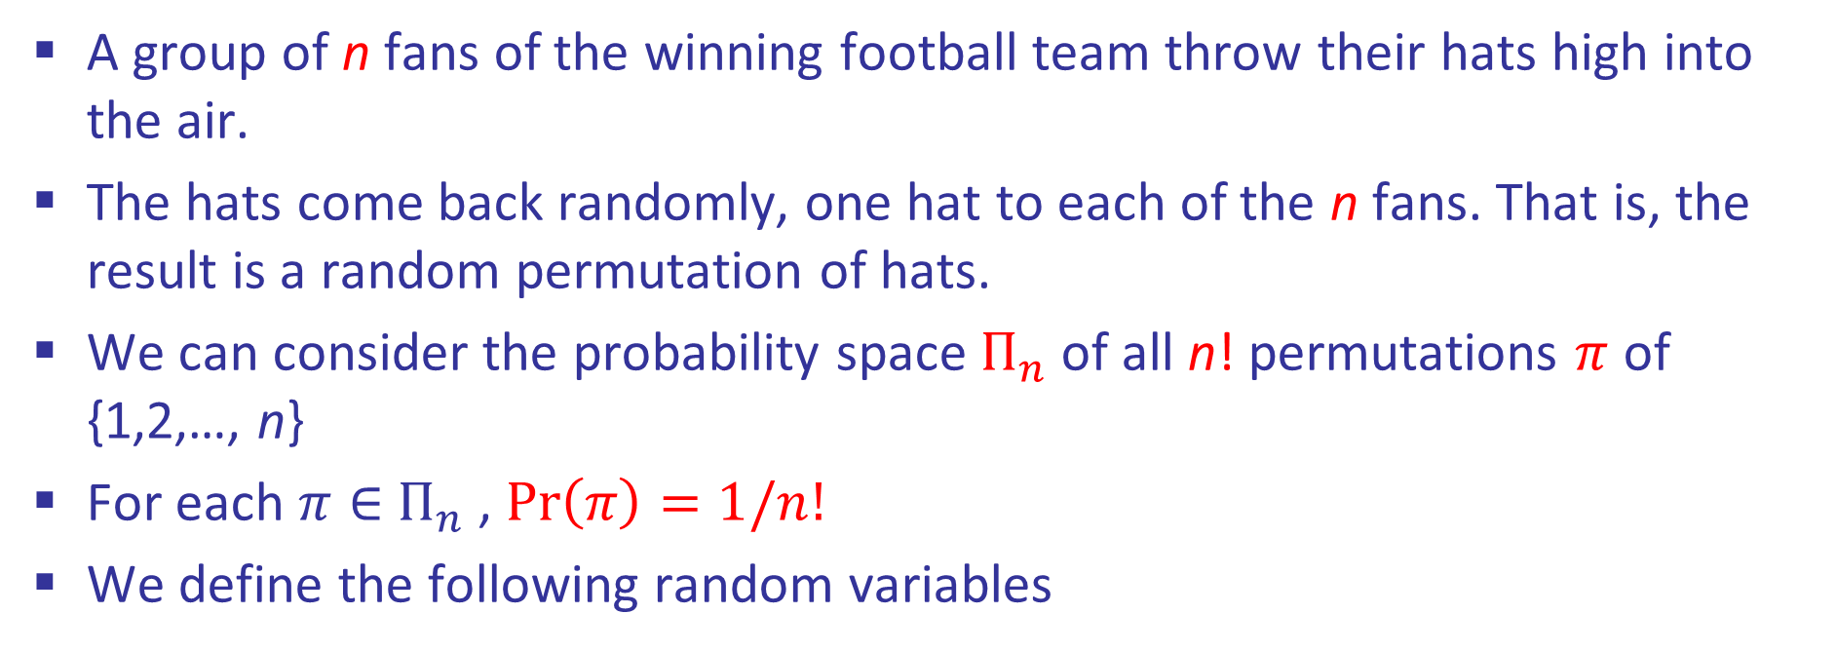

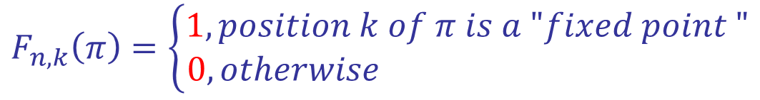
Football Victory Problem
A group of n fans of the winning football team throw their hats high into the air.
The hats come back randomly, one hat to each of the n fans. That is, the result is a random permutation of hats.
We can consider the probability space $П_{n}$ of all n! permutations $π$ of {1,2,…, n}
For each $π∈$ $П_{n}$ , $Pr\left(π\right)=1/n!$
We define the following random variables
$$F_{n,k}\left(π\right)=\left\{\begin{aligned}1, position k of π is a "fixed point " \\ 0, otherwise \end{aligned}\right.$$
$$F_{n}\left(π\right)=number of fixed points of π$$
$=$ $F_{n,1}\left(π\right)+F_{n,2}\left(π\right)+…+F_{n,n}\left(π\right)$

Slide 27




Football Victory Problem
Since $F_{n}\left(π\right)=$ $F_{n,1}\left(π\right)+F_{n,2}\left(π\right)+…+F_{n,n}\left(π\right)$
Hence, ${EF}_{n}=EF_{n,1}+EF_{n,2}+…+{EF}_{n,n}$
For each $F_{n,k}$, its expected value ${EF}_{n,k}=1/n$ because
$$EF_{n,k}$$
$$=1∙\operatorname{Pr}\left(F_{n,k}=1\right)+0∙\operatorname{Pr}\left(F_{n,k}=0\right)$$
$$=\operatorname{Pr}\left(F_{n,k}=1\right)$$
$$=\frac{\left(n−1\right)!}{n!}$$
$$=\frac{1}{n}$$
Therefore, ${EF}_{n}=n×\frac{1}{n}=1$
On the average, one hat will be in its correct place.
“A random permutation has one fixed point, on the average."

Slide 28

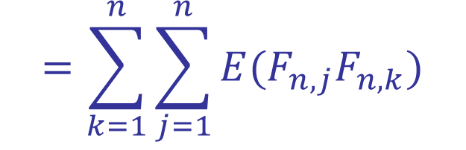
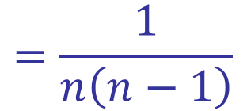
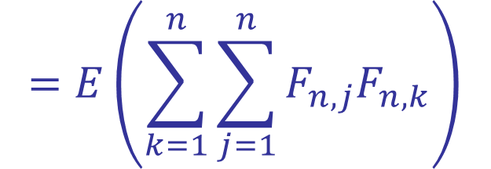

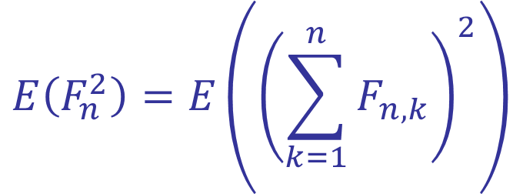
Football Victory Problem
To calculate the variance of $F_{n}$, we have
$$E\left(F_{n}^{2}\right)=E\left({\left(\sum_{k=1}^{n}{F_{n,k}}\right)}^{2}\right)$$
$$=E\left(\sum_{k=1}^{n}{\sum_{j=1}^{n}{F_{n,j}F_{n,k}}}\right)$$
$$=\sum_{k=1}^{n}{\sum_{j=1}^{n}{{E(F}_{n,j}F_{n,k})}}$$
$$=\sum_{1≤k≤n}{{E(F}_{n,k}^{2})}+2\sum_{1≤j<k≤n}{{E(F}_{n,j}F_{n,k})}$$
Since $F_{n,k}=1 or 0$, so $F_{n,k}^{2}=F_{n,k}$ and ${E(F}_{n,k}^{2})={E(F}_{n,k})=1/n$
$$=\frac{1}{n\left(n−1\right)}$$
${E(F}_{n,j}F_{n,k})=Pr(π has both j and k as fixed points)$
$$=\left(n−2\right)!/n!$$
Therefore, $E\left(F_{n}^{2}\right)=n∙\frac{1}{n}+\left(\begin{aligned}n \\ 2\end{aligned}\right)$ $\frac{2}{n\left(n−1\right)}=2$
The variance of $F_{n}$ is $E\left(F_{n}^{2}\right)−{\left(EF_{n}\right)}^{2}=2−1=1$

Slide 29
Content
8.1 Definitions
8.2 Mean and Variance
8.3 Probability Generating Functions
8.4 Flipping Coins
8.5 Hashing

Slide 30


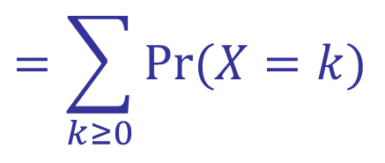
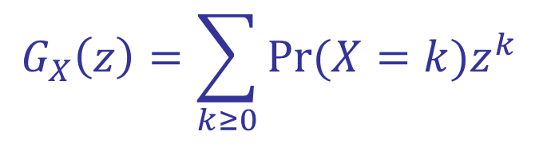
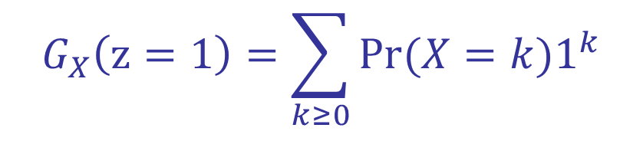
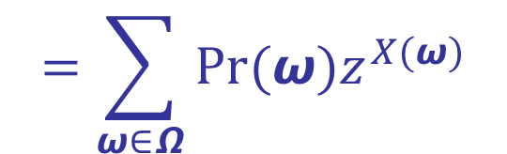
Probability Generating Function
If X is a random variable that takes only nonnegative integer values, then the probability generating function or pgf of X is
$$G_{X}\left(z\right)=\sum_{k≥0}{Pr⁡(X=k)z^{k}}$$
$$=\sum_{ω∈Ω}{Pr(ω)z^{X(ω)}}$$
$$=E(z^{X})$$
This power series in z contains all the information about the random variable X.
The coefficients of $G_{X}\left(z\right)$ are nonnegative, and they sum to 1
$$G_{X}\left(z=1\right)=\sum_{k≥0}{Pr⁡(X=k)1^{k}}$$
$$=\sum_{k≥0}{Pr⁡(X=k) }$$
$$=1$$
Conversely, any power series G(z) with nonnegative coefficients and with G(1) = 1 is the pgf of some random variable.

Slide 31

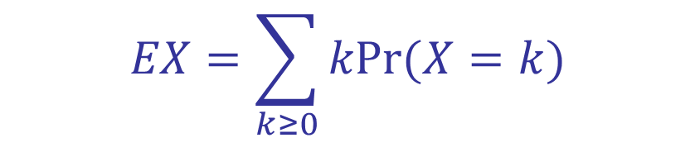
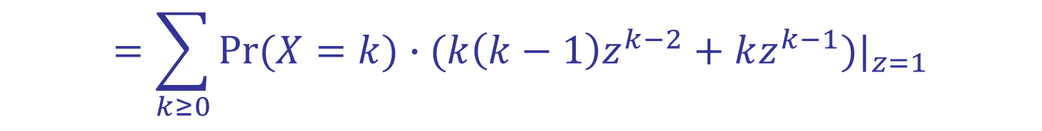
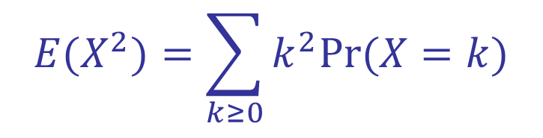

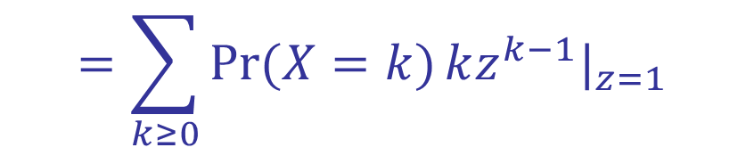
The Application of Probability Generating Function
To simplify the computation of means and variances
$$EX=\sum_{k≥0}{kPr(X=k)}$$
$$=\sum_{k≥0}{Pr(X=k)}kz^{k−1}|_{z=1}$$
$$=G_{X}^{′}(1)$$
We simply differentiate the pgf with respect to z and set z = 1.
$$E{(X}^{2})=\sum_{k≥0}{k^{2}Pr(X=k)}$$
$$=\sum_{k≥0}{Pr(X=k)}∙(k\left(k−1\right)z^{k−2}+kz^{k−1})|_{z=1}$$
$$=G_{X}^{′′}\left(1\right)+G_{X}^{′}(1)$$
$$VX=E{(X}^{2})−{\left(EX\right)}^{2}=G_{X}^{′′}\left(1\right)+G_{X}^{′}\left(1\right)−{(G_{X}^{′}\left(1\right))}^{2}$$

Slide 32


The Application of Probability Generating Function
Some probability generating functions are simple functions of z
Example: the uniform distribution of order n, in which the random variable takes on each of the values {0,1,2…, n-1} with probability 1/n. The pgf in this case is
$$U_{n}\left(z\right)=\frac{1}{n}(1+z+z^{2}+…+z^{n−1})$$
$$=\frac{1}{n}\frac{1−z^{n}}{1−z}$$
We have a closed form for $U_{n}\left(z\right)$ because this is a geometric series

Slide 33






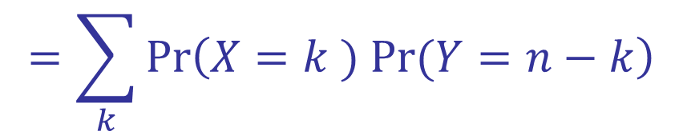



The Application of Probability Generating Function
If X and Y are two independent random variables that take integer values, then
$$G_{X+Y}\left(z\right)=G_{X}\left(z\right)G_{Y}\left(z\right)$$
This is because $\operatorname{Pr}\left(X+Y=n\right)=\sum_{k}{\operatorname{Pr}\left(X=k and Y=n−k\right)}$
$$=\sum_{k}{\operatorname{Pr}\left(X=k ) Pr⁡(Y=n−k\right)}$$
Let F(z) and G(z) be the pgf's for X and Y (they are independent), and let H(z) be the pgf for X + Y, then $H\left(z\right)=F\left(z\right)G\left(z\right)$
$$E\left(X+Y\right)=H^{′} \left(1\right)$$
$$=F^{′}\left(1\right)G\left(1\right)+F\left(1\right)G^{′}\left(1\right)$$
$$=F^{′}\left(1\right)+G^{′}\left(1\right)$$
$$=E\left(X\right)+E\left(Y\right)$$
Similarly, we can use pgf to show Var(X+Y)=Var(X)+Var(Y)
$$EX=G_{X}^{′}(1)$$
$$G_{X}\left(z=1\right)=1$$

Slide 34

The Application of Probability Generating Function
Mean and variance are merely two of an infinite series of so-called cumulant statistics
There also are higher-order cumulants that express more subtle properties of a distribution
The general formula
$$In G\left(e^{t}\right)=\frac{κ_{1}}{1!}t+\frac{κ_{2}}{2!}t^{2}+\frac{κ_{3}}{3!}t^{3}+\frac{κ_{4}}{4!}t^{4}+…$$
defines the cumulants of all orders, when G(z) is the pgf of a random variable.

Slide 35

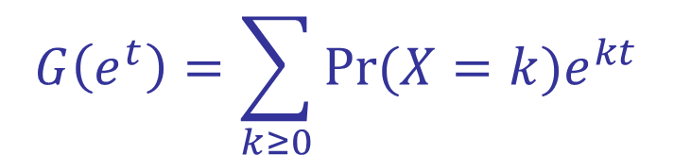
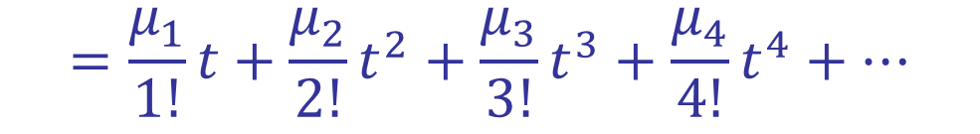
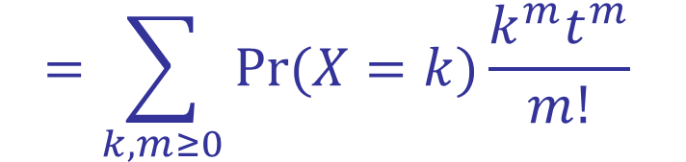
The Application of Probability Generating Function
If G(z) is the pgf for X, we have
$$G\left(e^{t}\right)=\sum_{k≥0}{Pr⁡(X=k)e^{kt}}$$
$$=\sum_{k,m≥0}{Pr⁡(X=k)\frac{k^{m}t^{m}}{m!} }$$
$$=\frac{μ_{1}}{1!}t+\frac{μ_{2}}{2!}t^{2}+\frac{μ_{3}}{3!}t^{3}+\frac{μ_{4}}{4!}t^{4}+…$$
where $μ_{m}=\sum_{k≥0}{\operatorname{Pr}\left(X=k\right)k^{m}=E(X^{m})}$ is called the “mth moment" of X

Slide 36






The Application of Probability Generating Function
If we can take exponentials on both sides of $In G\left(e^{t}\right)=\frac{κ_{1}}{1!}t+\frac{κ_{2}}{2!}t^{2}+…$
obtaining another formula for $G\left(e^{t}\right)$
$$G\left(e^{t}\right)=1+\frac{(κ_{1}t+\frac{1}{2}{κ_{2}t}^{2}+…)}{1!}+\frac{{(κ_{1}t+\frac{1}{2}{κ_{2}t}^{2}+…)}^{2}}{2!}+…$$
$$=1+κ_{1}t+\frac{1}{2} \left(κ_{2}+κ_{1}^{2}\right)t^{2}+…$$
Equating coefficients of powers of t leads to a series of formulas
$$κ_{1}=μ_{1}$$
Mean
$$κ_{2}=μ_{2}−μ_{1}^{2}$$
Variance

Slide 37
Content
8.1 Definitions
8.2 Mean and Variance
8.3 Probability Generating Functions
8.4 Flipping Coins
8.5 Hashing

Slide 38





The PGF for Tossing the Coin n Times
If we flip a coin, there's probability p that it comes up heads and probability q that it comes up tails, then $p+q=1$
The probability generating function for the number of heads (X) after one toss of a coin is
$H\left(z\right)=$ $\sum_{k≥0}{Pr⁡(X=k)z^{k}}$
$$=\operatorname{Pr}\left(X=0\right)z^{0}+\operatorname{Pr}\left(X=1\right)z^{1}$$
$$=q+pz$$
If we toss the coin n times and assume that different coin tosses are independent, the number of heads is generated according to the binomial theorem by
$${H(z)}^{n}={(q+pz)}^{n}=\sum_{k≥0}{\left(\begin{aligned}n \\ k\end{aligned}\right)p^{k}q^{n−k}z^{k}}$$
The chance that we obtain exactly k heads in n tosses

Slide 39







Tossing the Coin Until Heads First Turns Up
If we toss a coin repeatedly until heads first turns up. What is the probability that exactly k tosses will be required?
If k=1, then the probability is p. If k=2, then the probability is qp.
For general k, then the probability is $q^{k−1}p.$ So the corresponding pgf is
$$=\frac{pz}{1−qz}$$
$$pz+qpz^{2}+q^{2}pz^{3}+…$$
Repeating the process until n heads are obtained gives the pgf
$${(\frac{pz}{1−qz})}^{n}$$
$$=p^{n}z^{n}\sum_{k}{\left(\begin{aligned}n+k−1 \\ k\end{aligned}\right)}{(qz)}^{k}$$
$$=\sum_{k}{\left(\begin{aligned}k−1 \\ k−n\end{aligned}\right)}p^{n}q^{k−n}z^{k}$$
which is $z^{n}$ times the generating function for the negative binomial distribution
$${(\frac{p}{1−qz})}^{n}$$
$$=\sum_{k}{\left(\begin{aligned}n+k−1 \\ k\end{aligned}\right)}p^{n}q^{k}z^{k}$$
Notes:
$p^{n}z^{n}\sum_{k}{\left(\begin{aligned}n+k−1 \\ k\end{aligned}\right)}{(qz)}^{k}$ 参见5.2最后两页的等式
$p^{n}z^{n}\sum_{k}{\left(\begin{aligned}n+k−1 \\ k\end{aligned}\right)}{(qz)}^{k}$=$\sum_{k}{\left(\begin{aligned}k−1 \\ k−n\end{aligned}\right)}p^{n}q^{k−n}z^{k}$ 这个等式可以通过在前一个公式中把k用k-n替换得到。

Slide 40

Tossing the Coin Until Heads First Turns Up
The probability space of flipping a coin until n heads have appeared is different from the probability spaces we've seen earlier since it contains infinitely many elements.
Each element is a finite sequence of heads and/or tails, containing precisely n heads in all, and ending with heads; the probability of such a sequence is $p^{n}q^{k−n}$, where $k−n$ is the number of tails.
For example, if n = 3 and if we write H for heads and T for tails, the sequence THTTTHH is an element of the probability space, and its probability is $p^{3}q^{4}$

Slide 41







The PGF of Binomial Distribution
Let X be a random variable with the binomial distribution (depends on n, p)
$$Pr\left(X=k\right)=\left(\begin{aligned}n \\ k\end{aligned}\right)p^{k}q^{n−k}$$
$${H(z)}^{n}={(q+pz)}^{n}=\sum_{k≥0}{\left(\begin{aligned}n \\ k\end{aligned}\right)p^{k}q^{n−k}z^{k}}$$
The generating function of X is
$$EX=\sum_{k≥0}{kPr(X=k)}$$
$$=\sum_{k≥0}{Pr(X=k)}kz^{k−1}|_{z=1}$$
Recall
$$=G_{X}^{′}(1)$$
So, the mean of X is
$${[{H(1)}^{n}]}^{′}=n (pz)|_{z=1}=np$$
Recall
$$VX=E{(X}^{2})−{\left(EX\right)}^{2}=G_{X}^{′′}\left(1\right)+G_{X}^{′}\left(1\right)−{(G_{X}^{′}\left(1\right))}^{2}$$
So, the variance of X is
$${n(H}^{′′}\left(1\right)+H^{′}\left(1\right)−{H^{′}\left(1\right)}^{2})=n(0+p−p^{2}) =npq$$
Thus the standard deviation is $\sqrt{npq}$: If we toss a coin n times, we expect to get heads about $np±\sqrt{npq}$ times.

Slide 42


The PGF of Negative Binomial Distribution
Let Y be a random variable with the negative binomial distribution. Note that there are a couple of variations of the negative binomial distribution
Version 1: it counts the number of the trial at which the nth success occurs
$Pr\left(Y_{1}=k\right)=\left(\begin{aligned}k−1 \\ n−1\end{aligned}\right)p^{n}q^{k−n}$ //$k≥n$
Version 2: it counts the number of the failures before the nth success
$$Pr\left(Y_{2}=k\right)=\left(\begin{aligned}n+k−1 \\ k\end{aligned}\right)p^{n}q^{k}$$
If $Y_{1}$ is a negative binomial random variable according to the first definition, then $Y_{2}=Y_{1}−n$ a negative binomial according to the second definition.
We will use the 2nd version to derive the pgf

Slide 43








The PGF of Negative Binomial Distribution
Let Y be a random variable with the negative binomial distribution.
$$Pr\left(Y=k\right)=\left(\begin{aligned}n+k−1 \\ k\end{aligned}\right)p^{n}q^{k}$$
$$H\left(z\right)=\sum_{k≥0}{Pr⁡(X=k)z^{k}}=\sum_{k≥0}{\left(\begin{aligned}n+k−1 \\ k\end{aligned}\right)p^{n}q^{k}z^{k}}$$
$$=p^{n}\sum_{k≥0}{\left(\begin{aligned}n+k−1 \\ k\end{aligned}\right){(qz)}^{k}}$$
//$\left(\begin{matrix}r \\ k\end{matrix}\right)={(−1)}^{k}\left(\begin{matrix}k−r−1 \\ k\end{matrix}\right)$
$$=p^{n}\sum_{k≥0}{\{ \left(\begin{aligned}k−\left[n+k−1\right]−1 \\ k\end{aligned}\right){(−1)}^{k}\}{(qz)}^{k}}$$
$$=p^{n}\sum_{k≥0}{\left(\begin{aligned}−n \\ k\end{aligned}\right){(−qz)}^{k}}$$
$$={\left(\frac{p}{1−qz}\right)}^{n}$$
$$=p^{n}{(1−qz)}^{−n}$$

Slide 44






The PGF of Negative Binomial Distribution
If we let $G\left(z\right)=\left(\frac{p}{1−qz}\right)$, then we have
$$G^{′}\left(z\right)=\frac{pq}{{(1−qz)}^{2}}$$
$$G^{′′}\left(z\right)=\frac{2pq^{2}}{{(1−qz)}^{3}}$$
$$G^{′}\left(1\right)=\frac{pq}{{(1−qz)}^{2}}=\frac{pq}{p^{2}}=q/p$$
$$G^{′′}\left(1\right)=\frac{2pq^{2}}{p^{3}}=\frac{2q^{2}}{p^{2}}$$
//$p+q=1$
Since the pgf of Y is $H\left(z\right)={G(z)}^{n}$，then it follows that the mean of Y is $nq/p$ and the variance is $nq/p^{2}$

Slide 45

The PGF of Negative Binomial Distribution
A simpler way to derive the mean and variance of Y is to use the reciprocal generating function
$$F(z)=\frac{1−qz}{p}=\frac{1}{p}−\frac{q}{p}z$$
Hence, ${G(z)}^{n}={F(z)}^{−n}$
The polynomial F(z) is not a probability generating function, because it has a negative coefficient $−q/p$.
But it does satisfy the crucial condition F(1) = 1
Thus F(z) is formally a binomial that corresponds to a coin for which we get heads with “probability" equals to $−q/p$ (tail with a probability 1/p)
Thus G(z) is formally equivalent to flipping such a coin -1 times

Slide 46



The PGF of Negative Binomial Distribution
The negative binomial distribution with parameters (n, p) can therefore be regarded as the ordinary binomial distribution with parameters $\left(n^{′},p^{′}\right)=(−n,−q/p)$ [negative parameters, so it is called negative binomial distribution ]
Accordingly, the mean is $n^{′}p^{′}=\left(−n\right)\left(−\frac{q}{p}\right)=\frac{nq}{p}$
the variance is $n^{′}p^{′}q^{′}=\left(−n\right)\left(−\frac{q}{p}\right)\left(1+\frac{q}{p}\right)=\frac{nq}{p^{2}}$
This formal derivation involving negative probabilities is valid, because our derivation for ordinary binomials was based on identities between formal power series in which the assumption $0≤p≤1$was never used.

Slide 47
Content
8.1 Definitions
8.2 Mean and Variance
8.3 Probability Generating Functions
8.4 Flipping Coins
8.5 Hashing

Slide 48
Some Concepts
The general problem is to maintain a set of records that each contain a “key“ value, K, and some data D(K) about that key; we want to be able to find D(K) quickly when K is given.
The basic idea of hashing is to use m separate lists instead of one giant list.
A “hash function" transforms every possible key K into a list number h(K) between 1 and m.
0
∧
A
B
C
∧
1
D
2
∧
3
E
F
∧
4
∧
∧
5
G
6
∧

Slide 49


Analysis of Hashing
Let P be the number of probes when the algorithm (in Page 413) is used to carry out a search, which is the main quantity that governs the running time of the search procedure.
If n items have been inserted, their positions in the table depend only on their respective hash values, $<h_{1},h_{2},..,h_{n}>$.
Each of the $m^{n}$ possible sequences $<h_{1},h_{2},..,h_{n}>$ is considered to be equally likely, and P is a random variable depending on such a sequence.

Slide 50



Analysis of Hashing
Case 1: the key is not present
In this case, the search is unsuccessful and the relevant probability space consists of $m^{n+1}$ elementary events
$$ω=(h_{1},h_{2},..,h_{n},h_{n+1})$$
where $h_{j}$is the hash value of the jth key inserted, and where $h_{n+1}$ is the
hash value of the key for which the search is unsuccessful.
We assume that the hash function h has been chosen properly so that $Pr(ω)=1/m^{n+1}$ for every such $ω$.

Slide 51




Analysis of Hashing
Case 1: the key is not present
Example: if m = n = 2, there are eight equally likely possibilities
If $h_{1}=h_{2}=h_{3}$, we make two unsuccessful probes before concluding that the new key K is not present
If $h_{1}=h_{2}≠h_{3}$, we make none; and so on.
This list of all possibilities shows that P has a probability distribution given by the pgf $\left(\frac{2}{8}+\frac{4}{8}z+\frac{2}{8}z^{2}\right)={(\frac{1}{2}+\frac{1}{2}z)}^{2}$, when m=n=2.

Slide 52


Analysis of Hashing
Case 1: the key is not present
An unsuccessful search makes one probe for every item in list that is numbered with $h_{n+1}$, so we have the general formula
$$P=\left[h_{1}=h_{n+1}\right]+\left[h_{2}=h_{n+1}\right]+…+\left[h_{n}=h_{n+1}\right]$$
The probability that $h_{j}=h_{n+1} (1≤j≤n)$ is 1/m, so it follows that
$$EP=E\left[h_{1}=h_{n+1}\right]+E\left[h_{2}=h_{n+1}\right]+…+E\left[h_{n}=h_{n+1}\right]=n/m$$
Formally, let $X_{j}$ be the random variable $X_{j}$ $=X_{j}\left(ω\right)=\left[h_{j}=h_{n+1}\right]$, then $P=X_{1}+X_{2}+…+X_{n}$, and ${EX}_{j}=1/m$, hence
$$EP=EX_{1}+EX_{2}+…+EX_{n}=n/m$$
This means that the average number of probes is 1/m times what it was without hashing (sequential search)

Slide 53



Analysis of Hashing
Case 1: the key is not present
The random variables $X_{j}$ are independent, and they each have the same probability generating function
$X_{j}\left(z\right)=\operatorname{Pr}\left(X_{j}=0\right)z^{0}+\operatorname{Pr}\left(X_{j}=1\right)$ $z^{1}=\left(1−\frac{1}{m}\right)+\frac{z}{m}=\frac{m−1+z}{m}$
Hence, the pgf for the total number of probes in an unsuccessful search is
$$P\left(z\right)=X_{1}\left(z\right)…X_{n}\left(z\right)={(\frac{m−1+z}{m})}^{n}$$
This is a binomial distribution, with $p=1/m$and $q=1−\frac{1}{m}$
The number of probes in an unsuccessful search behaves just like the number of heads when we toss a biased coin whose probability of heads is $1/m$ on each toss.

Slide 54



Analysis of Hashing
Case 2: the key is present
Probability space： let $Ω$ be the set of all $m^{n}n$ elementary events
$$ω=(h_{1},h_{2},..,h_{n};k)$$
where ${1≤h}_{j}≤m$is the hash value of the jth key inserted, and where $1≤k≤n$ is the index of the key being sought (the key whose hash value is $h_{k}$)
Let $s_{j}$ be the probability that we are searching for the jth key that was inserted into the table. Then,
$$\operatorname{Pr}\left(ω\right)=\frac{s_{j}}{m^{n}} (8.87)$$
Note that $\sum_{ω∈Ω}{Pr\left(ω\right)}=\sum_{k=1}^{n}{s_{k}=1}$. Hence, the (8.87) defines a legal probability distribution.

Slide 55

Analysis of Hashing
Case 2: the key is present
The number of probes P in a successful search is p if key K was the pth
key to be inserted into its list.
$$P(h_{1},h_{2},..,h_{n};k)=\left[h_{1}=h_{k}\right]+\left[h_{2}=h_{k}\right]+…+\left[h_{k}=h_{k}\right]$$
Formally, let $X_{j}$ be the random variable $X_{j}$ $=\left[h_{j}=h_{k}\right]$, then we have $P=X_{1}+X_{2}+…+X_{k}$
Example: we have m = 10 and n = 16, and that the hash values have the following “random" pattern:
The number of probes $P_{j}$ needed to find the jth key is shown below $h_{j}$

Slide 56




Analysis of Hashing
Case 2: the key is present
We cannot simply calculate EP as $EX_{1}+EX_{2}+…+EX_{k}$ since the quantity k itself is random variable.
If X takes only nonnegative integer values, we can decompose its pgf into a sum of conditional pgf's with respect to any other random variable Y
$$G_{X}\left(z\right)=\sum_{y∈Y(Ω)}{Pr⁡(Y=y)G_{X|y}\left(z\right)}⁡$$
This holds because the coefficient of $z^{x}$on the left side is $Pr⁡(X=x)$, for all $x∈X(Ω)$and on the right it is

Slide 57




Analysis of Hashing
Case 2: the key is present
If we let X = P and Y = K. For any fixed k between 1 and n, the random variable P|k is defined as a sum of independent random variables $X_{1}+X_{2}+…+X_{k}$. So
$$G_{P|k}\left(z\right)={\left(\frac{m−1+z}{m}\right)}^{k−1}z⁡$$
Therefore the pgf for P itself is
$$G_{P}\left(z\right)=\sum_{k=1}^{n}{s_{k}G_{P|k}\left(z\right)}=\sum_{k=1}^{n}{s_{k}{(\frac{m−1+z}{m})}^{k−1}}z=zS(\frac{m−1+z}{m})⁡$$
where $S\left(z\right)=s_{1}+s_{2}z+s_{3}z^{2}+…+s_{n}z^{n−1}$ is the pgf for the search probabilities $s_{k}$ (divided by z for convenience).

Slide 58



Analysis of Hashing
Case 2: the key is present
We have a pgf for P, so we can find the mean and variance by differentiation. It's somewhat easier to remove the z factor first, thus finding the mean and variance of P - 1 instead:
$$F\left(z\right)=\frac{G_{P}\left(z\right)}{z}=S(\frac{m−1+z}{m})⁡$$
$$F^{′}\left(z\right)=\frac{1}{m}S^{′}(\frac{m−1+z}{m})⁡$$
$$F^{′′}\left(z\right)=\frac{1}{m^{2}}S^{′′}(\frac{m−1+z}{m})⁡$$
Therefore
$$EP=1+mean\left(F\right)=1+F^{′}\left(1\right)=1+m^{−1}mean(S)⁡$$
$$VP=var\left(F\right)=F^{′′}\left(1\right)+F^{′}\left(1\right)−{F^{′}\left(1\right)}^{2}={m^{−2}S}^{′′}\left(1\right)+{m^{−1}S}^{′}\left(1\right)−m^{−2}{S^{′}(1)}^{2}⁡$$
$$=m^{−2}Var(S)+{(m}^{−1}−m^{−2})mean(S) ⁡$$

Slide 59






Analysis of Hashing
Case 2: the key is present
For example, suppose we have $s_{k}=1/n$. This means we are doing a purely “random" successful search, with all keys in the table equally likely.
Then S(z) is the uniform probability distribution $U_{n}(z)$, we have
$$mean\left(S\right)=(n−1)/2$$
$$var\left(S\right)=(n^{2}−1)/12$$
Hence,
$$EP=\frac{n−1}{2m}+1$$
$VP=\frac{n^{2}−1}{12m^{2}}+\frac{\left(m−1\right)\left(n−1\right)}{2m^{2}}=\frac{\left(n−1\right)\left(6m+n−5\right)}{12m^{2}}⁡$
Once again we have gained the desired speedup factor of $1/m$. If $m=\frac{n}{\ln{n}}$ and $n→+∞$，the average number of probes per successful search in this case is about $½\ln{n}$. The standard deviation is asymptotically $\ln{n}/\sqrt{12}$.

Slide 60
本章作业
8,7, 8.8, 8.18(a)

